Slide 1

Zomato Restaurant Insights
Group 2

Slide 2
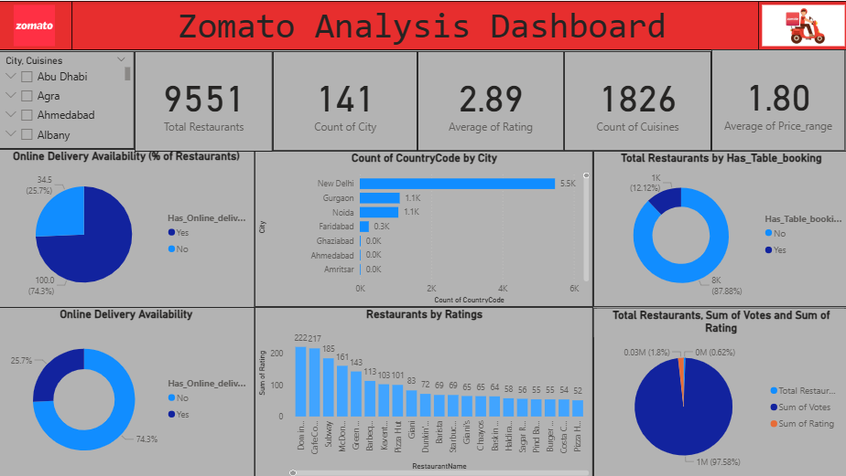

Power Bi Dashboard

Slide 3

Key Metrics at a Glance
9,551
141
2.89
Total Restaurants
Cities Covered
Avg. Customer Rating
Diverse urban presence
Across the dataset
Overall satisfaction score
1,826
Cuisines Offered
Wide culinary variety

Slide 4
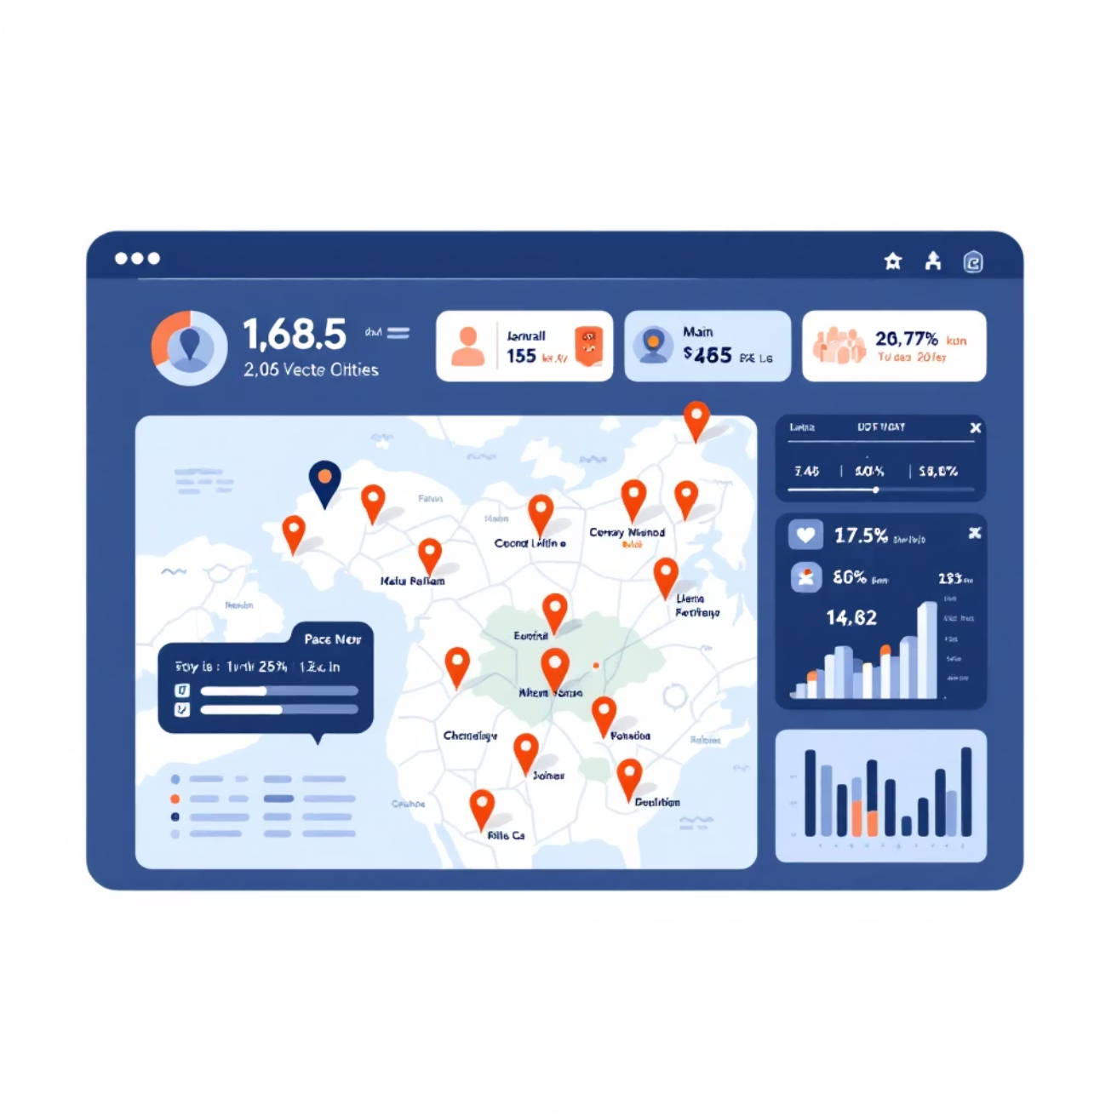
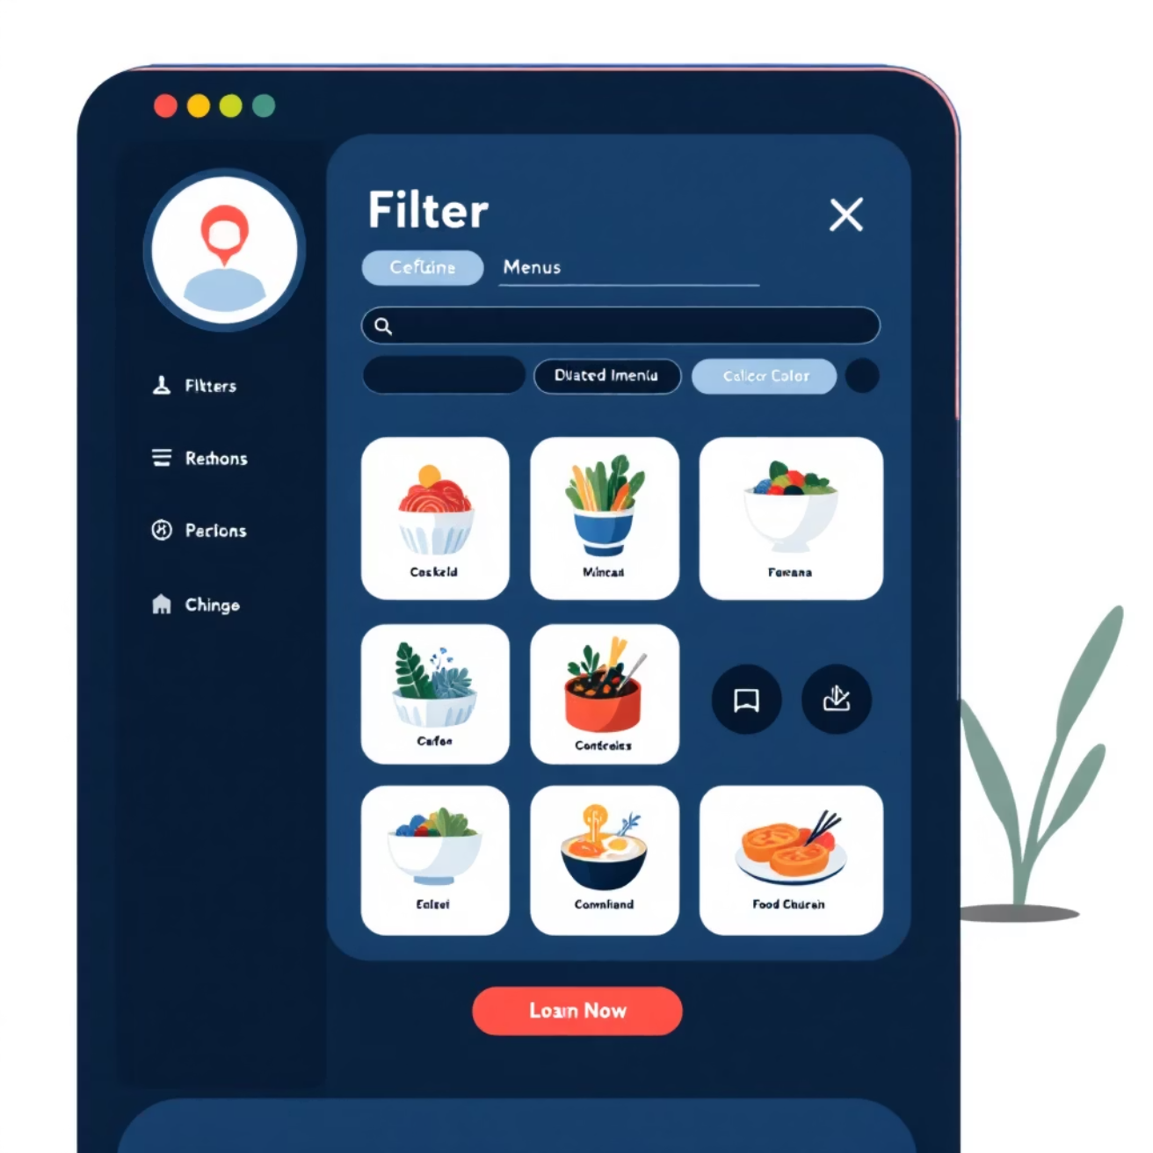
Dashboard Interaction: Filters
City Filter
Cuisine Filter
Analyze restaurant data by specific cities.
Explore performance across various cuisines.
Empowering users to drill down into specific segments for deeper analysis.

Slide 5
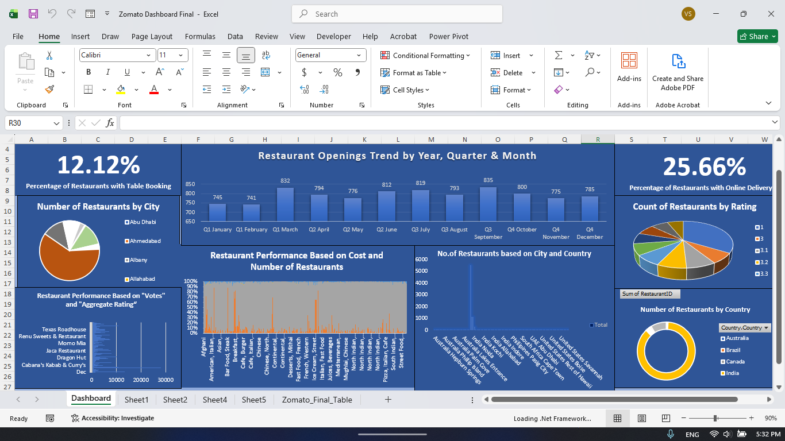
Excel Dashboard

Slide 6
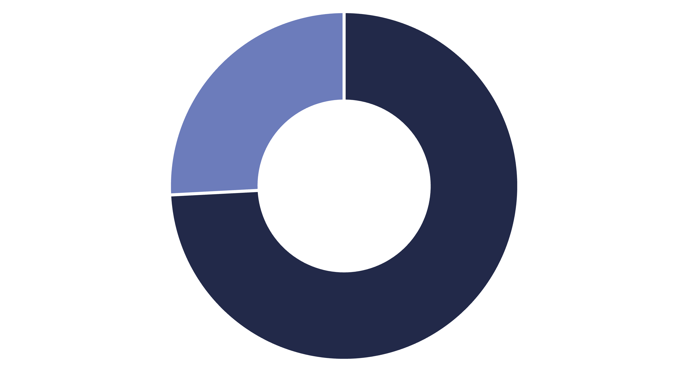
Online Delivery Availability
Available
Not Available
A significant majority of restaurants offer online delivery services.

Slide 7
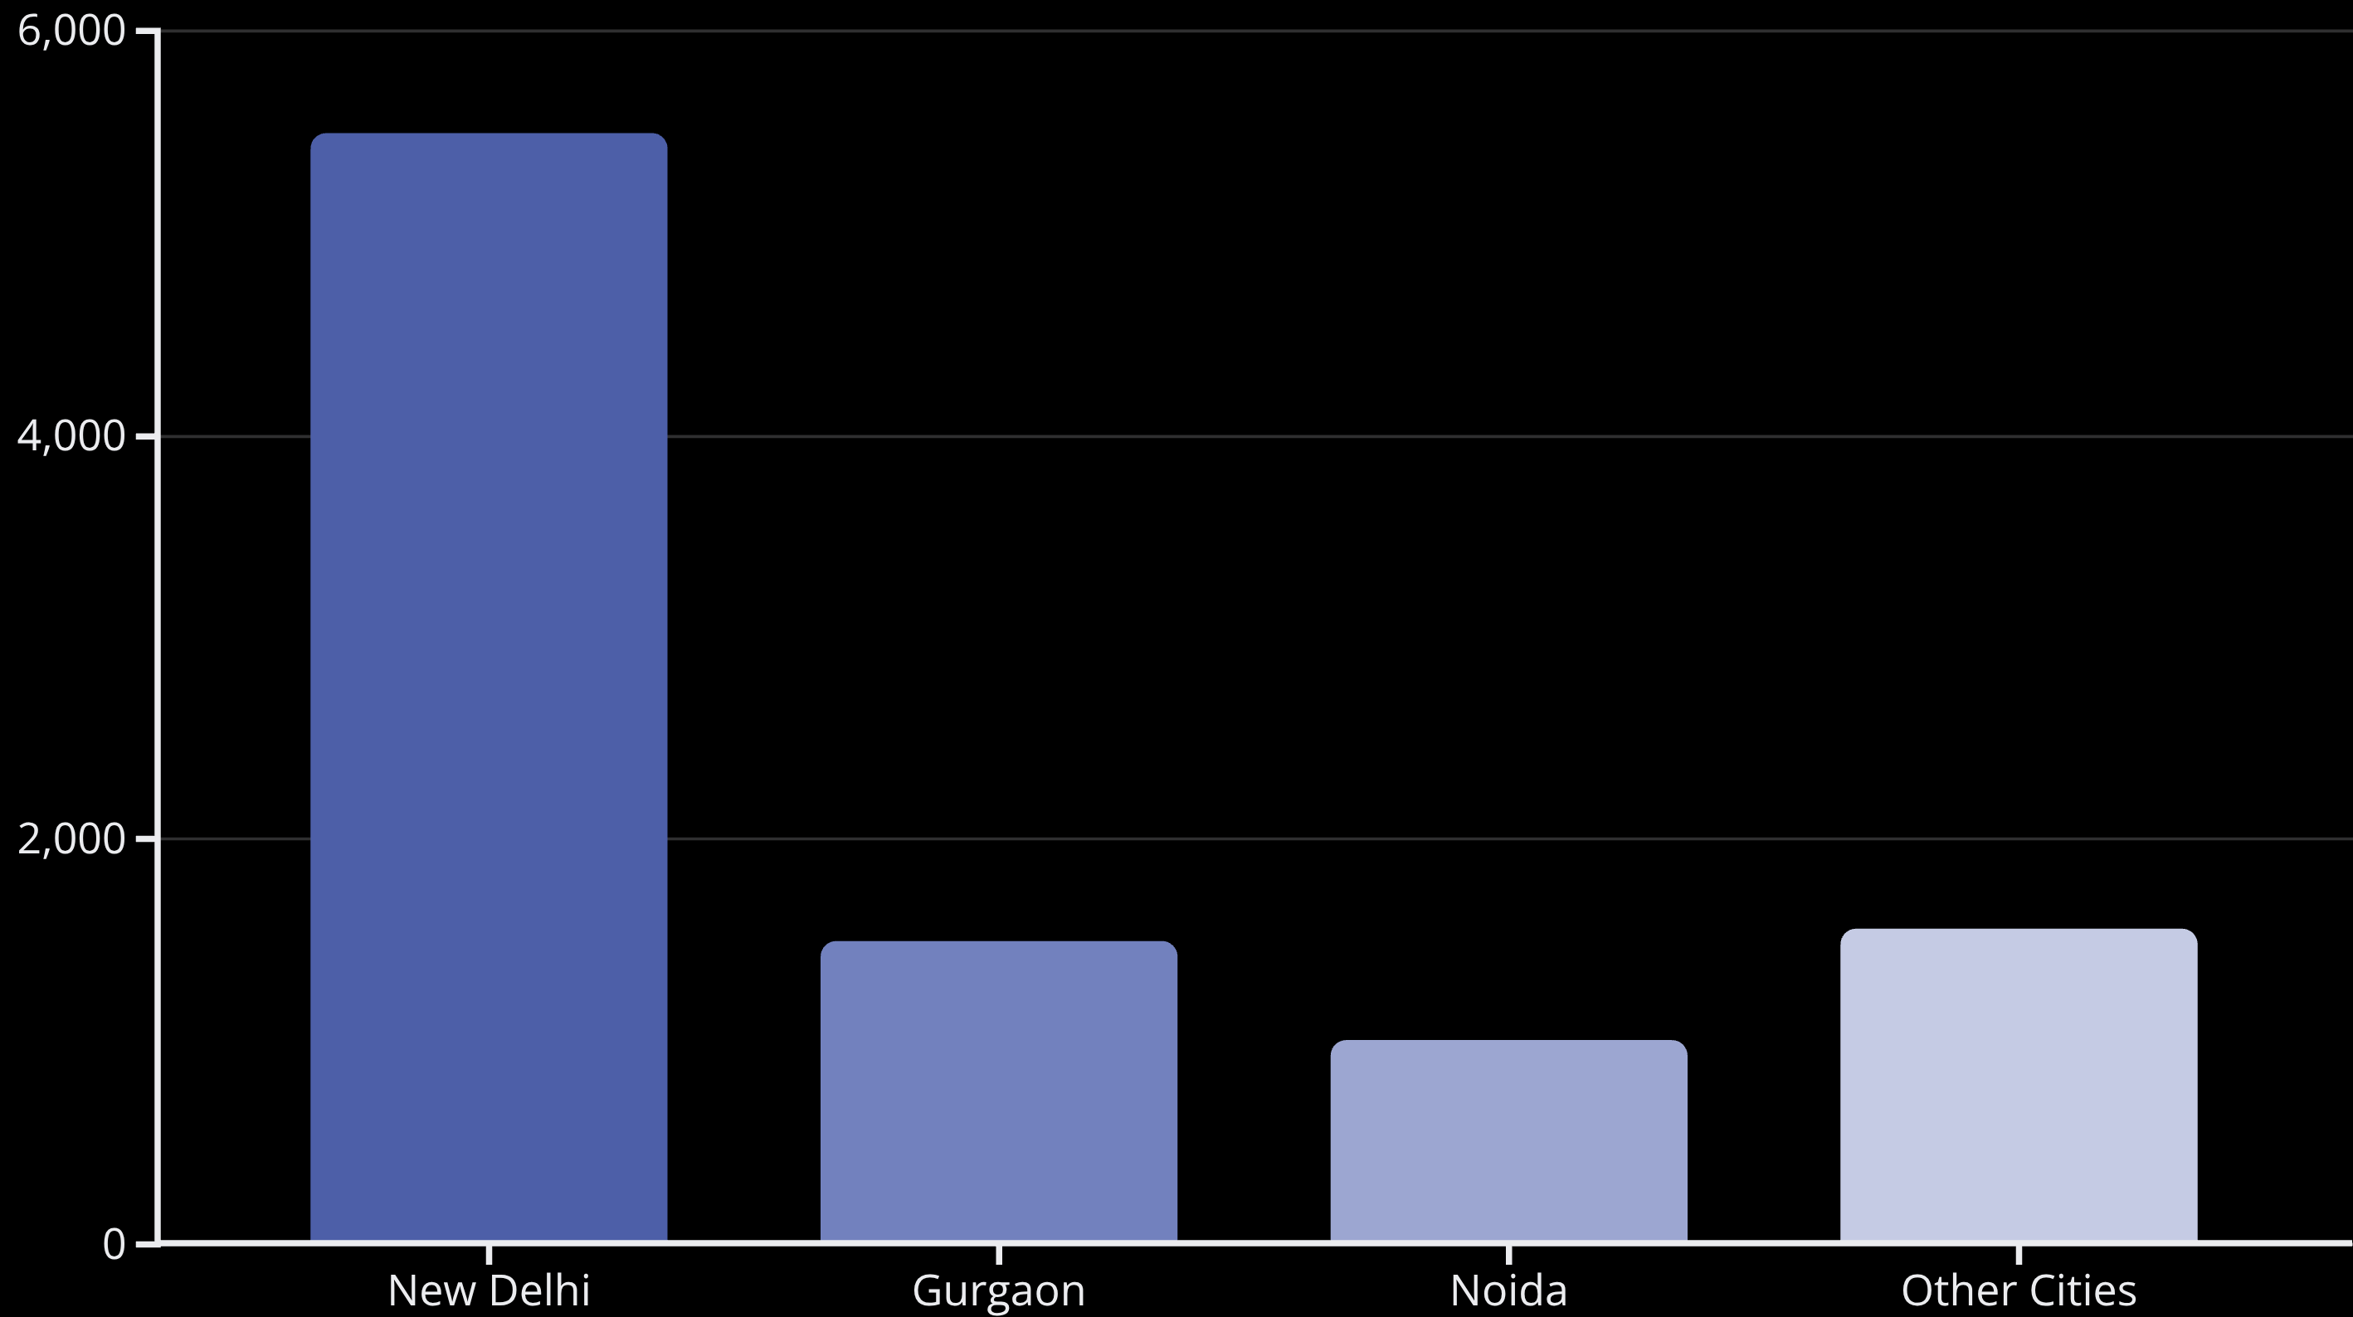
City-wise Restaurant Distribution
New Delhi leads with approximately 5.5K restaurants, followed by Gurgaon and Noida.

Slide 8

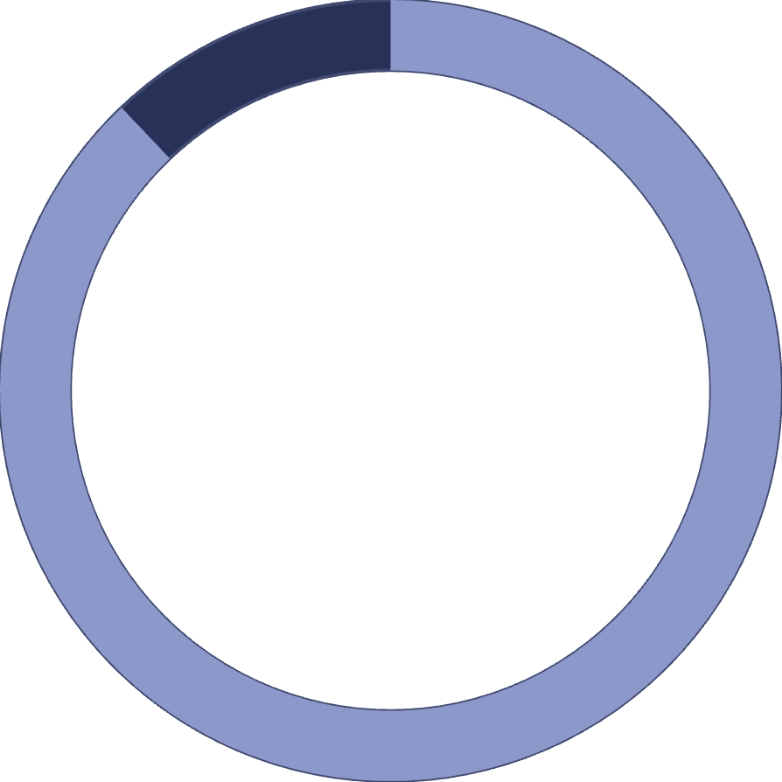
Table Booking Availability
12.1%
87.9%
Offer Booking
No Booking
Restaurants providing table reservation services.
Restaurants without table booking options.

Slide 9
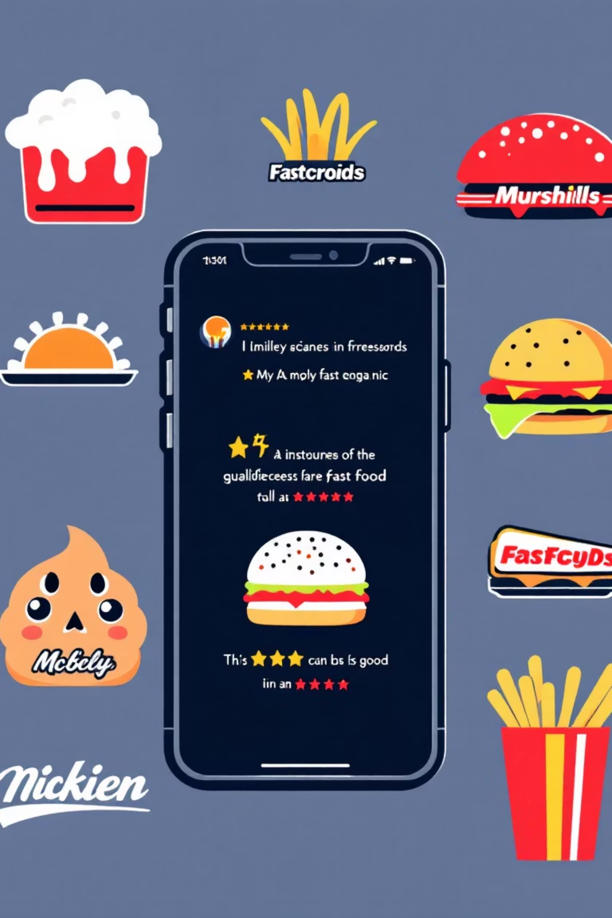



Restaurant Ratings Analysis
Popular Chains Excel
Brand Recognition
Domino's, Café Coffee Day, Subway, McDonald's receive higher ratings.
Strong brands correlate with increased customer satisfaction.
Rating Trends
Insights into customer preferences and loyalty.

Slide 10








Driving Data-Driven Decisions
Restaurant Performance
Customer Behavior
Understand operational strengths and weaknesses.
Insights into preferences and engagement.
Strategic Planning
Service Improvement
Support informed business decisions for growth.
Identify areas for enhancing customer experience.

